Slide 2
Learn how to improve .NET application performance, leveraging Azure Code Optimizations
Jan Kalis
Ryan Kahng
Product Managers
Code Optimizations
Microsoft Azure

Slide 3
Agenda
What is Code Optimizations (Preview)
Where does it fit to the app development process
How it can help to remediate performance issues
1st Demo
Deep dive into Code Optimizations
How to enable it & prerequisites
2nd Demo
Code Optimizations Extension (Preview) for VS Code
How it can help you fix the performance issue on a code level faster
3rd Demo

Slide 4
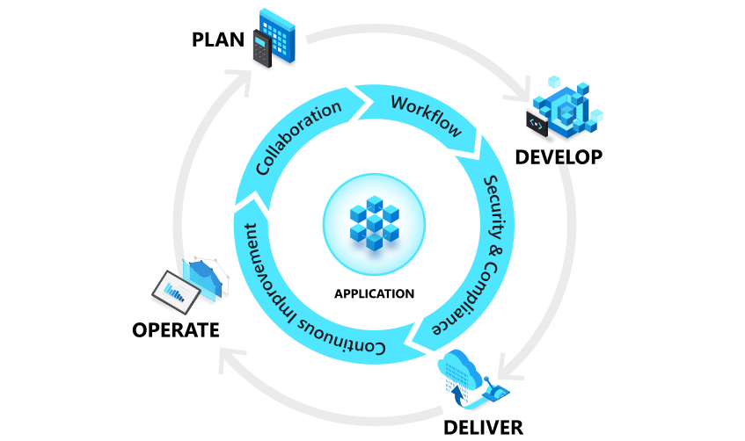
Where can Code Optimizations help?

Slide 5
What is Code Optimizations?
AI-based service identifies performance issues and offers recommendations for .NET apps on Azure
Codifies learnings from running high-scale cloud applications into an AI-based model
Works in tandem with the Application Insights Profiler
Detects CPU and memory usage performance issues at a code level during application runtime
Compares the behavior to performance engineering best practices

Slide 6
How does Code Optimizations help customers?
Customers who use Code Optimizations find that it helps*:
improve user experience before it causes an incident (proactive)
investigate an incident (reactive)
Just found out about the feature. I am basically done with my investigation and pretty much came up with the same results..
Another awesome feature! Insights continue to improve over time. Great job, team!
What you currently offer is excellent. It helps us find out which areas need optimization BEFORE it becomes a problem for our end users.
* Based on Microsoft’s survey of current users. More than 50% of those who use code Optimizations use it proactively , 30% reactively.

Slide 7
1st Demo
Quick overview

Slide 8
How to Enable Code Optimizations?
Make sure you:
Connect your app to Application Insights
Enable Application Insights Profiler
Verify that Application Insights Profiler is collecting profiles
Supported platforms (as of November 2023)
Source https://learn.microsoft.com/azure/azure-monitor/profiler/profiler-overview
Documentation aka.ms/CodeOptimizationsTroubleshooting
Compute platform | .NET (>= 4.6) | .NET Core
Azure App Service | Yes | Yes
Azure Virtual Machines and Virtual Machine Scale Sets for Windows | Yes | Yes
Azure Virtual Machines and Virtual Machine Scale Sets for Linux | No | Yes
Azure Cloud Services | Yes | Yes
Azure Container Instances for Windows | No | Yes
Azure Container Instances for Linux | No | Yes
Kubernetes | No | Yes
Azure Functions | Yes | Yes
Azure Service Fabric | Yes | Yes

Slide 9
2nd Demo
Enabling Code Optimizations for App Service

Slide 10
Code Optimizations Extension (Preview) for VS Code
Limited Preview announced on November 15th
Can accelerate time to remediation by suggesting a performance code fix identified by App Insights Code Optimizations
Seamlessly integrates with VS Code (requires GitHub Copilot)
Connected workflow via GitHub:
increases transparency in Ops/DevOps and Dev communication
formalizes review process
Sign-up or learn more aka.ms/CodeOptimizations/VSCode

Slide 11
3rd Demo
Code Optimizations Extension for VS Code

Slide 12
Summary and Next Steps
What is Code Optimizations and how to enable it
Code Optimizations Extension (Preview) for VS Code
Sessions:
Ignite: BRK233, Amanda Silver, CVP, Developer Division, Microsoft
Resources:
Documentation aka.ms/CodeOptimizations
Troubleshooting aka.ms/CodeOptimizationsTroubleshooting
VS Code extension aka.ms/CodeOptimizations/VSCode
Next:
Enable or view your Code Optimizations
Let us know your feedback (via in-product feedback)

Slide 13
Download .NET 8
https://aka.ms/get-dotnet-8

